Slide 1
CSE 111 Project
Michael Issa & Alexander Fudala

Slide 2



Environment/Language
For our database we will use PostgreSQL
We will use the React Native framework with Expo to run our application

Slide 3
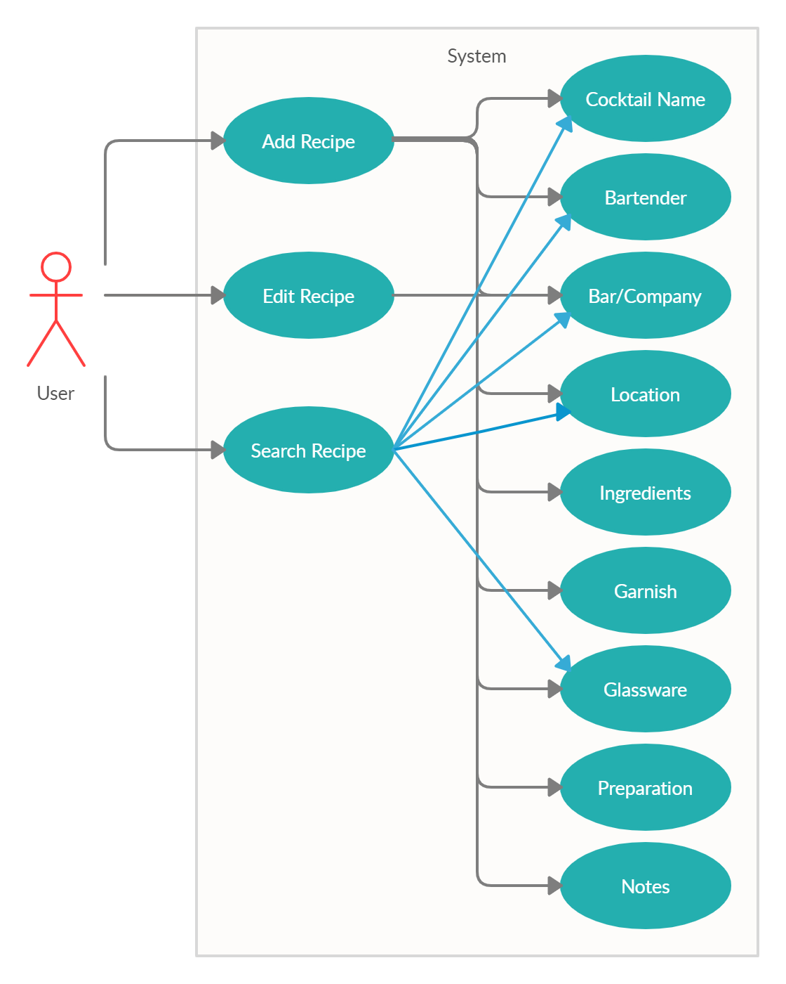
The user will access a wide list of cocktails
When the user selects the data-base, it will display a list of different types of cocktails
User can add, edit, and search through the different cocktails

Slide 4
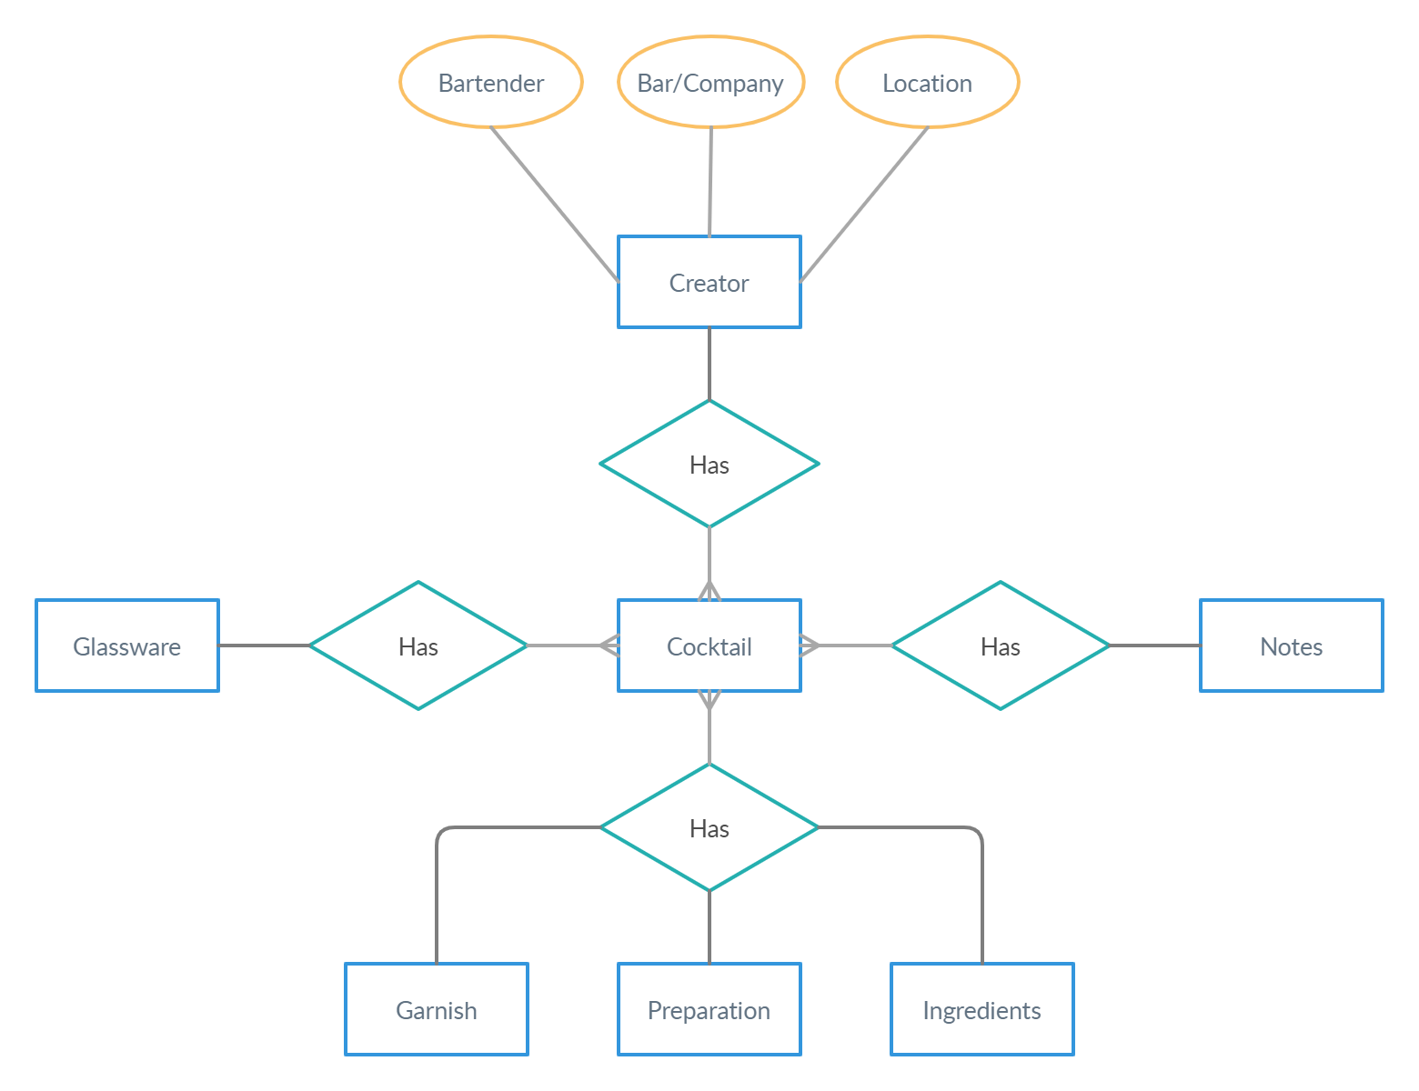
E/R Diagram

Slide 5
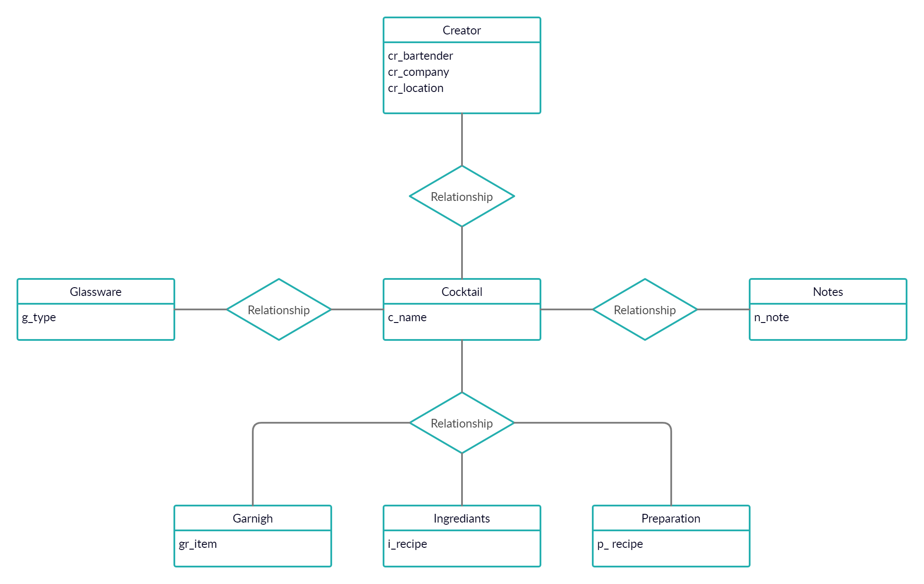
Relation Specification

